Slide 1
New Restaurant in New York City
The Battle of Neighbourhood

Slide 2
Introduction
New York City is one of the most densely populated city in the US, and it is financial capital of the country. Thus, it attracts people from different communities/society across the globe.
There are huge varieties of cuisine available in NYC and market is very competitive.
For a New Business owner for a dream to open a new restaurant is indeed a problem of battle of neighbourhoods.

Slide 3
PROBLEM
Restaurant should have cuisines based demographics of the area.
Price range of the cuisine should also considered as per the neighbourhoods’ per capita income.
To study whether restaurant market is saturated in given borough.
Availability of fresh ingredients to serve better to the customers
To find best location for the new restaurant

Slide 4
Data Overview
We will use data of NYC’s population, demographics and popular cuisine.
We have data of Farmers’ Market location based on neighbourhoods, borough and geo-coordinate locations.
We will access Foursquare database for venues in New York City.

Slide 5
Methodology
Analytical Approach
NYC Population Study
Farmers Market Cluster Study
Cuisine’s Word Cloud
NYC Venues Cluster

Slide 6
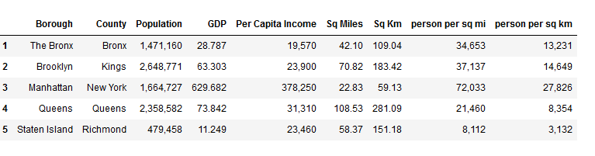
New York City Population

Slide 7
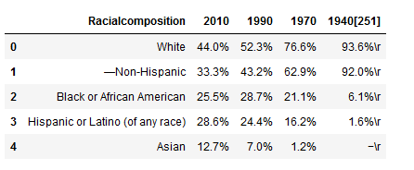
New York City - Demographics

Slide 8
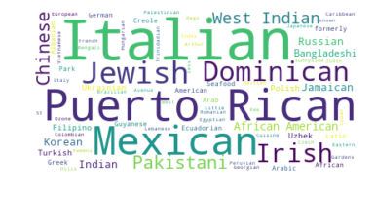
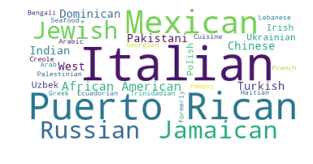
Popular Cuisines
NYC Cusines
Brooklyn Cuisine

Slide 9
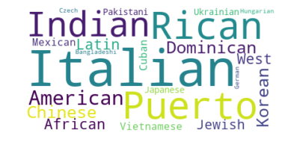
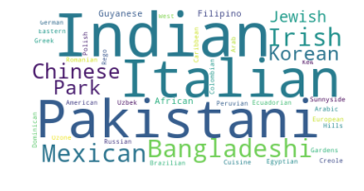
Popular Cuisines…
Manhattan Cuisines
Queens Cuisines

Slide 10
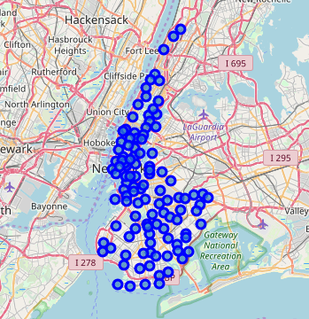
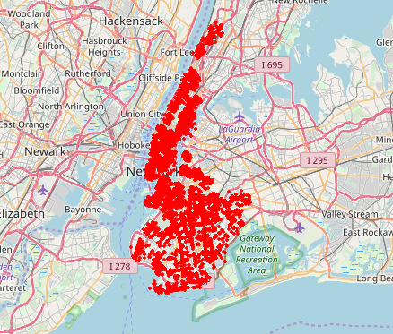
Neighbourhood and Venue
Brooklyn & Manhattan
Neighbourhood Map
Brooklyn & Manhattan
Venue Map

Slide 11
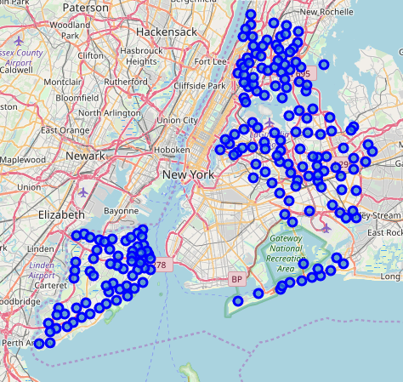
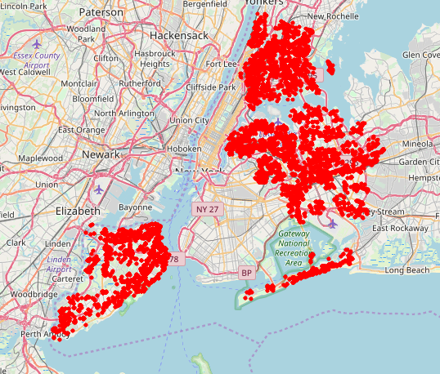
Neighbourhood and Venue
Bronx, Queens, Staten Island
Neighbourhood Map
Bronx, Queens, Staten Island
Venue Map

Slide 12
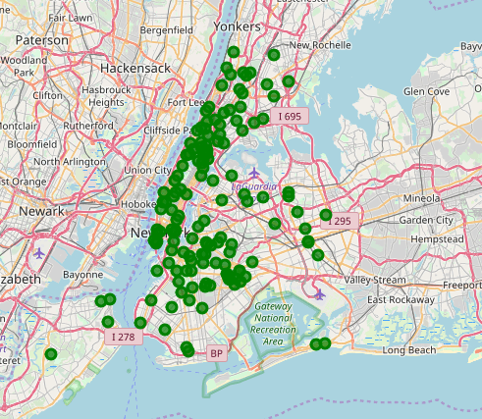
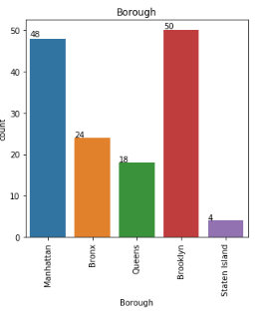
Farmer Market
Bronx, Queens, Staten Island
Venue Map

Slide 13
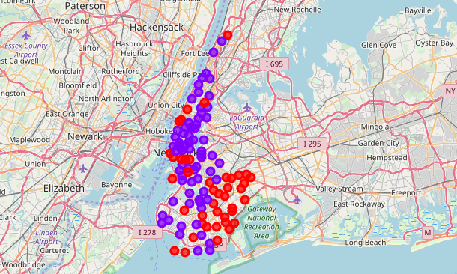
Clustering
Restaurant Cluster in Brooklyn and Manhattan
Bronx, Queens, Staten Island
Venue Map
0
It shows that the market is not saturated
1
It shows that the markets are saturated

Slide 14
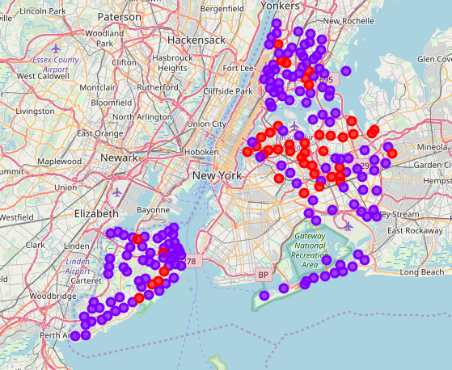
Clustering
Restaurant Cluster in Bronx, Queens & Staten Island
Bronx, Queens, Staten Island
Venue Map
0
It shows that the market is not saturated
1
It shows that the markets are saturated

Slide 15
Discussion
There is scope for restaurant in Bronx, Queens and Staten Island.
There is scope to explore cuisines of various countries in Bronx, Queens and Staten Island.
In Manhattan and Brooklyn restaurants of cuisines of many countries are available. So if risk can be taken with great menu on board. It also shows people love eating cuisines of various countries.

Slide 16
Conclusion
This analysis is performed on limited data. This may be right or may be wrong. But if good amount of data is available there is scope to come up with better results. If there are lot of restaurants probably there is lot of demand. Brooklyn and Manhattan has high concentration of restaurant business. Very competitive market. Bronx, Queens and Staten Island also has good number of restaurants but not as many as required. So this can be explored.
Based on per capita and population density, Manhattan and Brooklyn are suitable place for new restaurant but market is almost saturated in these boroughs.
Further, based on farmers’ market data, availability of fresh ingredients may have identified best in Brooklyn and lowest in Staten Island. And since Brooklyn has competitive restaurant market where as Staten Island is almost untapped for the restaurant, and not to mention per capital in Brooklyn and Staten Island is almost same but there is huge different in population. We have cuisine data for the Brooklyn and we do not have sufficient data for the Staten Island.
As per the neighbourhood or restaurant type mentioned like Indian Restaurant analysis can be checked. A venue with lowest risk and competition can be identified.

Slide 17
THANK YOU!
Wali Farooqui
Email:
walifarooqui@gmail.com

